Slide 1
PROJECT DESIGN PROCESS - 1

Slide 2
TEAM DETAILS :
TEAM ID | PNT2022TMID32216
PROJECT NAME | CONTAINMENT ZONE ALERTING APPLICATION

Slide 3
PROJECT DESCRIPTION :
PROJECT IDEA :
This application is intended to provide information about containment zones in a particular region by alerting people, through continuous monitoring of an individual's location. Key benefits of the application are monitoring people's activity and alerting them to their safety movements.

Slide 4
SOLUTION REQUIREMENT :
The project aims at building an application that provides information about the containment zones of a particular region by continuously monitoring an individual's location. The location of the individual must be stored in the Database. Alerts are sent using the notification service.

Slide 5
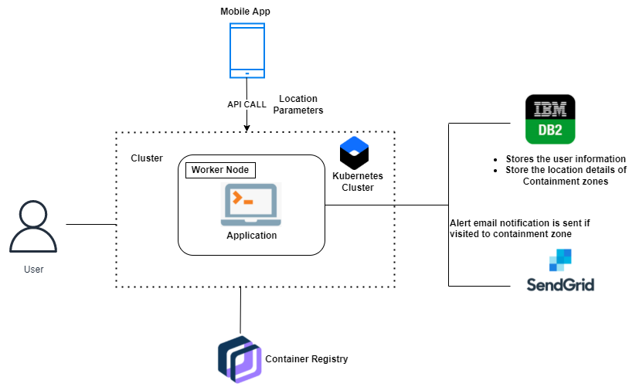
TECHNICAL ARCHITECTURE :
MODEL – 1:

Slide 6
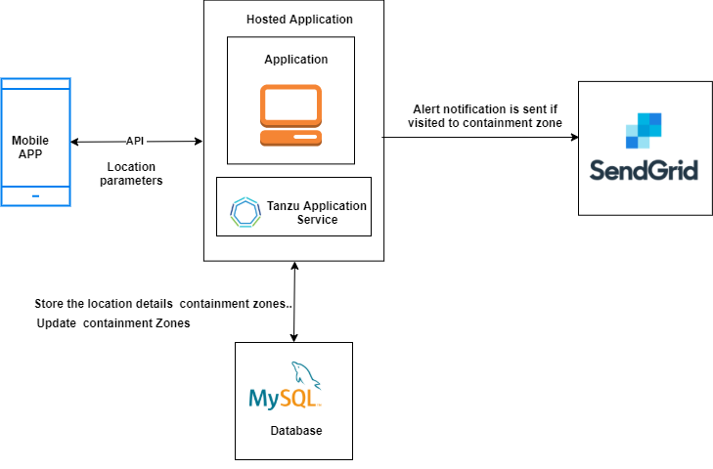
TECHNICAL ARCHITECTURE :
MODEL – 2 :

Slide 7
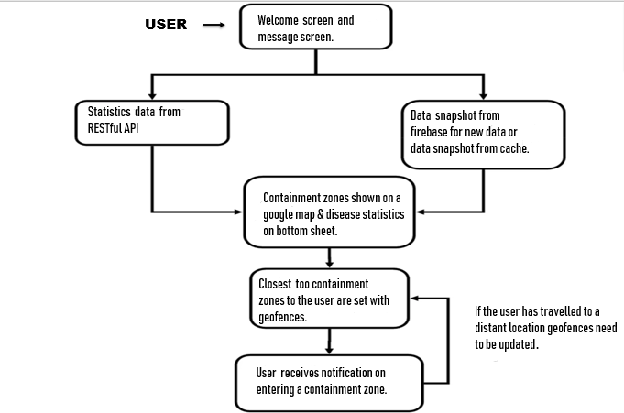

Slide 8
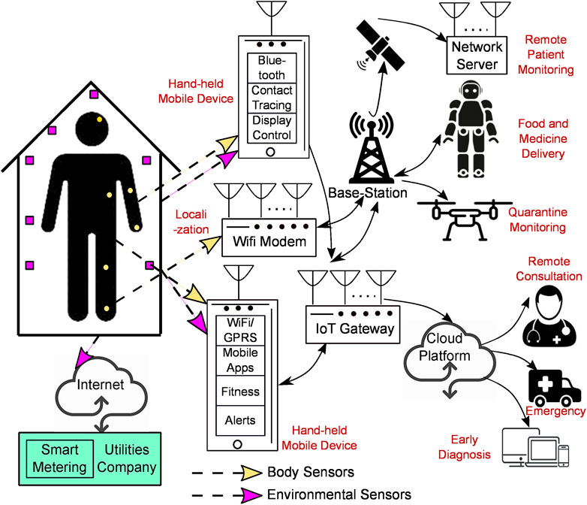
WORK FLOW :

Slide 9
THANK YOU …

